Slide 1
sales Prediction of online retail
Capstone Project BIA batch- December 2023 – Yashank Karanwal

Slide 2
AGENDA
Introduction
Approach
Exploratory Data Analysis
Feature Engineering
Model Results
Conclusion

Slide 3
INTRODUCTION

Slide 4
Problem Statement
The goal of this project is to analyze and understand the sales data from an online retail store. By conducting a comprehensive exploratory data analysis (EDA), we aim to uncover patterns, trends, and insights that can help improve business decisions related to inventory management, marketing strategies, and customer behavior. Additionally, we seek to build predictive models that can forecast future sales and identify potential high-value customers.

Slide 5

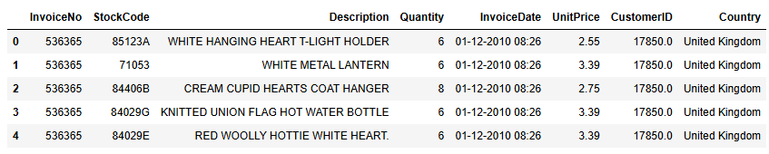
Data description
The dataset is a transactional dataset of an online retail store. The data includes all the transactions occurring between 01/12/2010 and 09/12/2011 for a UK-based and registered non-store online retail. It contains information on transactions such as invoice number, product codes, descriptions, quantities, invoice dates, unit prices, customer IDs, and countries.

Slide 6
Features DESCRIPTION
InvoiceNo: Invoice number. A unique number assigned to each transaction. Nominal data.
StockCode: Product (item) code. A unique number assigned to each distinct product. Nominal data.
Description: Product (item) name. Nominal data.
Quantity: The quantities of each product (item) per transaction. Numeric data.
InvoiceDate: The date and time when the transaction was generated. DateTime data.
UnitPrice: Unit price. Numeric data.
CustomerID: Customer number. A unique number assigned to each customer. Nominal data.
Country: The name of the country where the customer resides. Nominal data.
Understanding these features helps in dissecting the data accurately and making informed predictions.

Slide 7
approach

Slide 8
approach
Exploratory Data Analysis
Feature Engineering
Modelling

Slide 9
EXPLORATORY DATA ANALYSIS

Slide 10
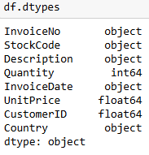
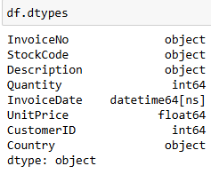
Changing datatypes
First step in EDA is to check for the datatypes in our dataset. So, we get to know that the datatypes of InvoiceDate is in object format and CustomerID is in float format. So, we need to change the datatypes of InvoiceDate and CustomerID to int and datetime respectively.
In this step, we have changed the datatypes of InvoiceDate and CustomerID to int and datetime format respectively which is quite evident from the picture.
This step is crucial for ensuring data consistency and accuracy in subsequent analyses.

Slide 11
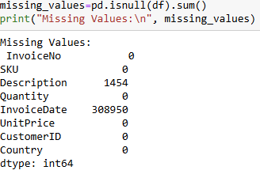
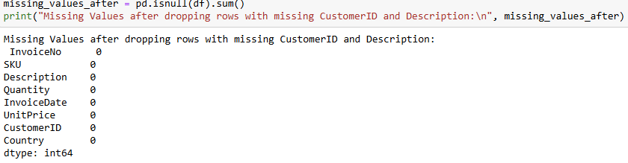
handling null values
Second step in EDA is to check for the null values in our dataset. we get to know that there are 1454 null values in Description and 308950 null values in InvoiceDate features of the dataset. Now, our next step will be to remove all the null values in the dataset.
In this step, we have removed the null values present in Description and InvoiceDate features which is quite evident from the picture.
This is essential to prevent errors in analysis and ensure the reliability of our findings.

Slide 12
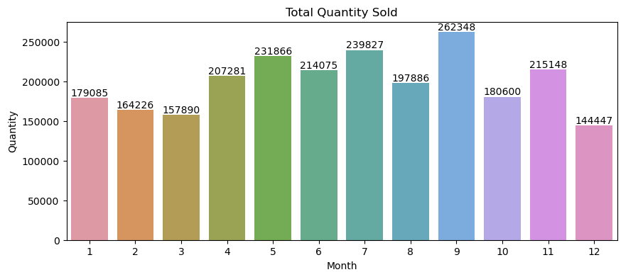
Monthly sales by quantity
Total sales appear to be increasing over the year. There is an upward trend in the line graph.
There is some seasonality to the data. Sales appear to be higher in some months than others. For example, sales appear to be the highest in the month of September compared with the other months.
Understanding these trends helps in planning inventory and marketing activities around peak sales periods.

Slide 13
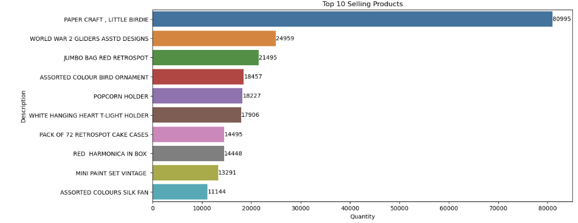
Top 10 selling products
Paper crafts are the most popular product, followed by World War 2 gliders and jumbo red retro spot bags. This suggests that people are interested in inexpensive, creative activities and nostalgic items.
The popularity of bird-themed items (little birdie, assorted colour bird ornament) suggests a trend in home decor.
Knowing the top-selling products helps in stock prioritization and targeted promotions.

Slide 14
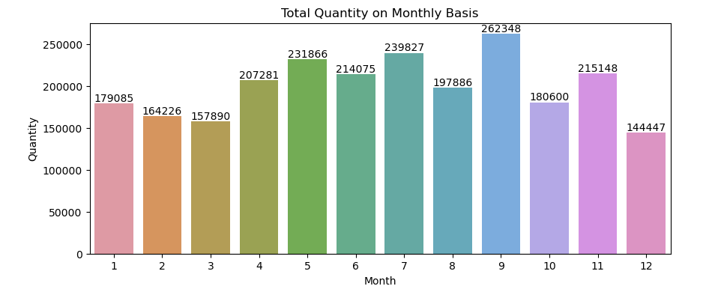
Total quantity on monthly basis
The graph indicates a seasonal pattern in marketing role quantity. There are fluctuations throughout the year, with a potential decline in December (month 12).
Despite the seasonal variations, there seems to be an overall increasing trend in the total quantity of marketing roles across the year.
These trends are crucial for understanding seasonality and demand fluctuations.

Slide 15
Feature engineering

Slide 16
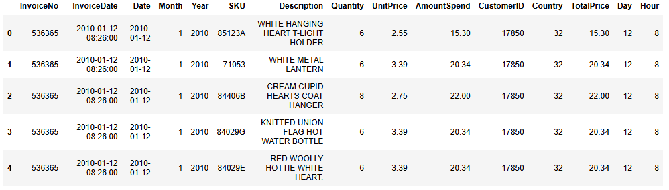
Created New Features:
Created a TotalPrice feature by multiplying the quantity of items by their unit price to understand the revenue from each transaction.
Extracting Date-Related Features:
Extracted year, month, day, and hour from InvoiceDate to capture seasonal trends and the impact of the time of day on sales.
Encoding Categorical Variables:
Transformed country names into numerical values using Label Encoding to ensure compatibility with our machine learning models.
Defining Features and Target Variable:
Selected key features such as quantity, unit price, country, and date details to predict the total revenue (TotalPrice) from each transaction.

Slide 17
Models and results

Slide 18
Models results
So, after fitting all these 4 models, we can easily conclude that the model best suited for our dataset is Decision Tree having the least MSE(115.14) and the highest R2 score(97.29%).
LINEAR REGRESSION
DECISION TREE
RANDOM FOREST
GRADIENT BOOSTING
Train MSE-12363.69
Train R2 Score-93.66%
Test MSE-3513.08
Test R2 Score-17%
Train MSE-1.29
Train R2 Score-99.12%
Test MSE-115.14
Test R2 Score-97.29%
Train MSE-20168
Train R2 Score-89.65%
Test MSE-173.64
Test R2 Score-95.91%
Train MSE-123.62
Train R2 Score-99.93%
Test MSE-454.39
Test R2 Score-89.28%

Slide 19

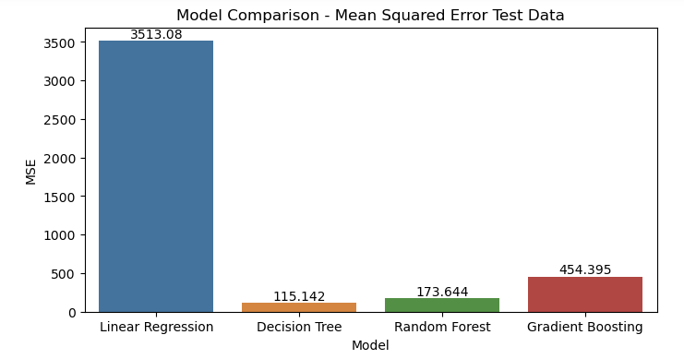
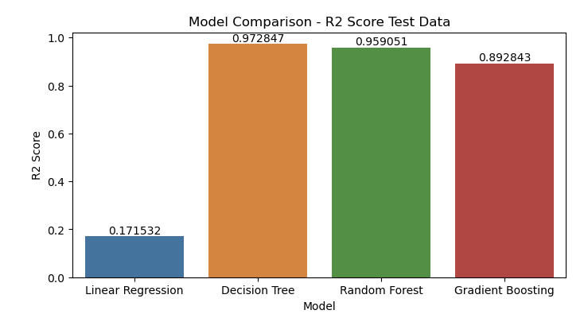

Slide 20
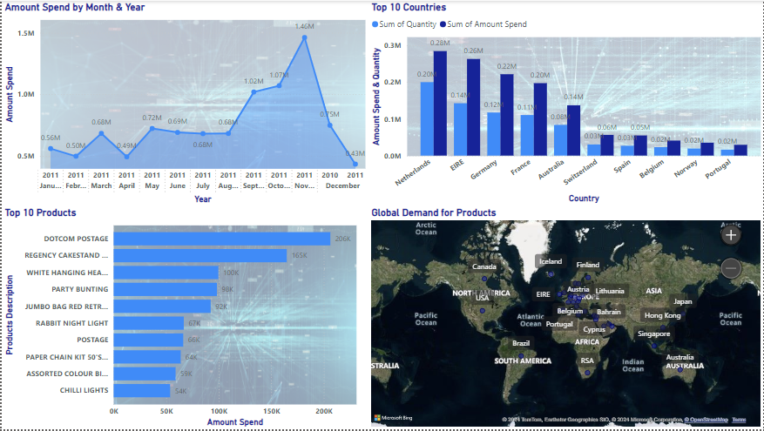
Power bi

Slide 21
conclusion
Keeping the right stuff in stock: We can identify what is popular and what sells seasonally. This means we have more of what customers want and less of what gathers dust on the shelves.
Reaching the right people: We can understand our customer base better. This allows us to send targeted promotions and special offers to the people who are most likely to be interested. It's like having a bullseye for our marketing.
Predicting the future: By analysing past sales, we can guess what will be popular in the future. This helps us prepare for upcoming trends and avoid running out of stock.

Slide 22
Thank you

